Slide 1
FINANCIAL CORPORATION USING KYC SYSTEM
WDL AND DBMS PROJECT done by roll no. 36,37,38

Slide 2
INTRODUCTION:
The financial service website provides the user with facilities of accessing verified property estate ,business opportunity of posting property and insurance services through kyc.
KYC (Know Your Customer) Guidelines issued by RBI are attached to Prevention of Money Laundering Act.]
Banks and other financial institutions ascertain the truthfulness and accuracy of your documentation before they on board you as a customer and monitor your relationship for fraud management thereafter.
KYC looks at your: - Identification - Location - Right to Authorize.

Slide 3
What does our site offer?
Our site offers easy verification of users through kyc process.
Being verified users ,the property posted by them are verified which increases business opportunity
Other users get verified information and authenticate pricing about the property.
The users gets to select an insurance plan, with secured tansactions.

Slide 4
PROCEDURE FOR KYC
USER SIDE:
Register and log in for new users
Fill Kyc form
The user can enter all the personal details through the kyc form.
Will get a unique kyc no.
Admin Side:
Admin log in
The Admin can view all the details (retrieve specific details)
The Admin can also fill the form for other users i.e add them to database
The Admin can also update the details

Slide 5
Features Of DATABASE
In Our database we have 3 tables linked using primary and foreign key constraints.
The kyc_account has the the kyc_number as a primary key constraint which is mapped as foreign key in contact and bank_account.
INSERT QUERY ON kyc_account :
INSERT INTO `kyc_account`(`bank_no`, `preffix`, `firstname`, `lastname`, `pan_no`, `adhar_no`, `home_name`, `area`, `land_mark`, `town`, `city`, `country`, `occupation`, `kyc_no`) VALUES ([value-1],[value-2],[value-3],[value-4],[value-5],[value-6],[value-7],[value-8],[value-9],[value-10],[value-11],[value-12],[value-13],[value-14])
ADD PRIMARY KEY FOREIGN KEY CONSTRAINTS:
ALTER TABLE `bank_account` ADD FOREIGN KEY (`kyc_no`) REFERENCES `kyc_account`(`kyc_no`) ON DELETE RESTRICT ON UPDATE RESTRICT;
JOINS ARE USED TO DISPLAY CONTENTS OF TWO TABLES HAVING PRIMARY KEY, FOREIGN KEY CONSTRAINT:
SELECT * FROM kyc_account k, contact c WHERE k.kyc_no=c.kyc_no AND k.kyc_no=‘$kyc’ ”;
The bank_account has the bank account number as primary key mapped in the kyc_account.
The data is retrieved using join sql queries.

Slide 6
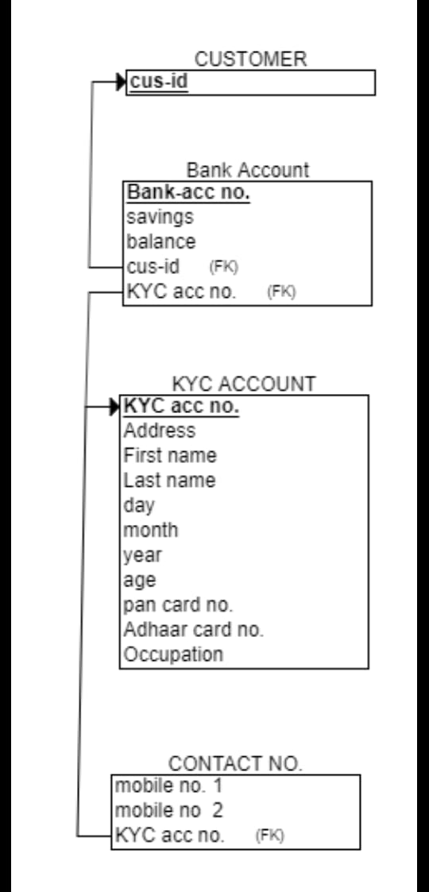

Slide 7
PROCEDURE FOR INSURANCE
The User can view details for Life Plan Insurance
There is eligibility criteria that is 18 yrs.
One Cannot proceed without agreeing to the terms and conditions, if interested in insurance
Prompted to enter kyc no to proceed
After correct kyc no. is entered, session starts

Slide 8
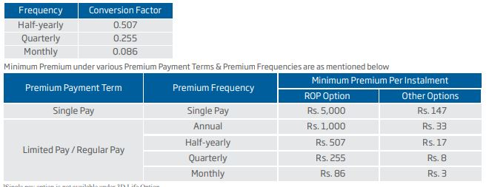
Premium calculator using javascript
For premium calculator, From the Premium Payment the options are Single-Annual,Semi-Annual,Quaterly,Monthly.
From Premium Payment Mode the options are Single Pay, Regular,Limited Pay.
After calculating premium, a kyc verified customer can apply for insurance.

Slide 9
Procedure FoR REAL ESTATE
Uploading Of Property
The user can enter all the details and also the image of his property.
Rent and Buy
The user can select his budget, preference and location and get the output of the appropriate property
The website will display all the property details according to the user.

Slide 10
CONCLUSION AND FUTURE SCOPE
Our project “Financial Cooperation” aims to know each of its customers details so as to ensure that financial services are not misused.
By verifying each of the customer there is an assurance that the services like insurance, real estate and all transactions are executed in a secure manner.
Our project idea can be used by real estate and insurance agencies to verify their customers and provide verified services.
In future, we can add other softwares like image processing and verification of official documents for having verification proof after kyc
We can also add Net banking and credit/debit card gateways to purchase insurance.

